Slide 1
User Research
Supporting People With Dementia

Slide 2
What did we do for our research?
Information from the internet (Studies, Data, etc.)
Read papers about dementia
Interview with a woman with Alzheimer’s

Slide 3
Data from Alzheimer’s Research UK

Slide 4
Alzheimer’s Disease
Develops slowly over the years
Caused by death of brain cells
Symptoms vary (Depends on which part of the brain is affected)
Most common symptom: Memory loss
Early, Middle and Late Stage

Slide 5
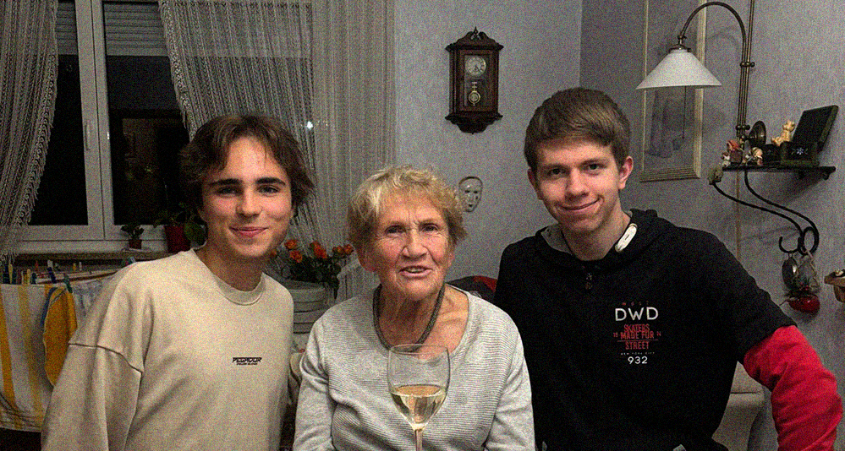
Interview with Margot

Slide 6
What does here every day life look like?
Caregivers visit her in the morning and in the evening
She helps at an elderly home
She likes going out with friends and walking in the park
Her son visits her a few times per week

Slide 7
What problems does she encounter?
Having trouble recognizing the people, that surround her
Not being able to accomplish step by step tasks
Misplacing things (Keys, Bags, etc.)

Slide 8
What technology does she use?
Mobile phone (no smartphone)
Television
Emergency button
Air Tag

Slide 9
What does she need?
Someone or something helping her remember every day tasks
Observation
Concise and recognizable design
Design from her past

Slide 10
Our first ideas
Help people with Alzheimer’s maintain their Quality of Life
More independence from family members and caregivers
Reminder (Audio User Interface)
Always-on-bracelet with audio function
Cooking helper

Slide 11
Sources
https://dementiastatistics.org/about-dementia/subtypes/
https://www.alz.org/alzheimers-dementia/10_signs
https://www.alz.org/alzheimers-dementia/stages

